Slide 1
ALDEHYDES, KETONES AND CARBOXYLIC ACIDS

Slide 2
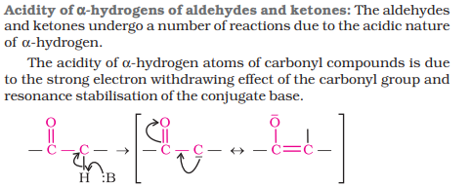
REACTION DUE TO α HYDROGEN

Slide 3
ALDOL CONDENSATION

Slide 4
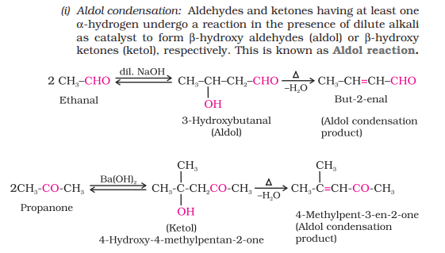

Slide 5
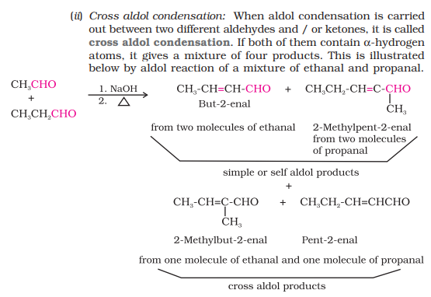

Slide 7
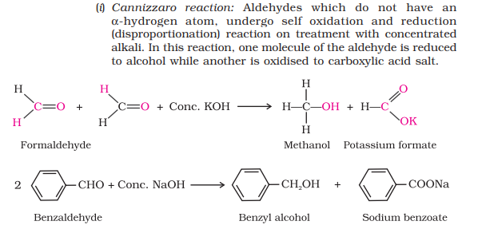

Slide 8
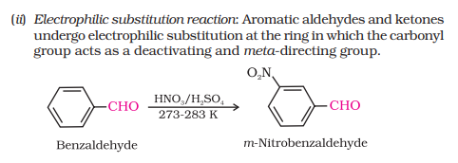

Slide 9
USES OF ALDEHYDES AND KETONES
In chemical industry aldehydes and ketones are used as solvents starting materials and reagents for the synthesis of other products.
Formaldehyde is well known as formalin (40%) solution used to preserve biological specimens and to prepare bakelite (a phenol-formaldehyde resin), urea-formaldehyde glues and other polymeric products.
Acetaldehyde is used primarily as a starting material in the manufacture of acetic acid, ethyl acetate, vinyl acetate, polymers and drugs.
Benzaldehyde is used in perfumery and in dye industries.
Acetone and ethyl methyl ketone are common industrial solvents.
Many aldehydes and ketones, e.g., butyraldehyde, vanillin, acetophenone, camphor, etc. are well known for their odours and flavours.

Slide 10
CARBOXYLIC ACIDS
Carboxylic Acids Carbon compounds containing a carboxyl functional group, –COOH are called carboxylic acids.
The carboxyl group, consists of a carbonyl group attached to a hydroxyl group, hence its name carboxyl.
Carboxylic acids may be aliphatic (RCOOH) or aromatic (ArCOOH) depending on the group, alkyl or aryl, attached to carboxylic carbon.
Large number of carboxylic acids are found in nature. Some higher members of aliphatic carboxylic acids (C12 – C18) known as fatty acids, occur in natural fats as esters of glycerol.
Carboxylic acids serve as starting material for several other important organic compounds such as anhydrides, esters, acid chlorides, amides, etc.

Slide 11
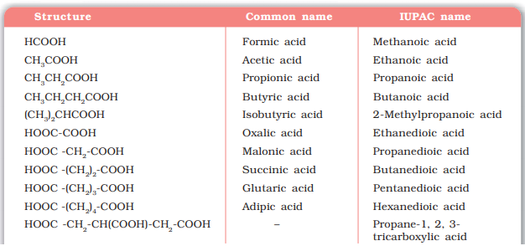

Slide 12
STRUCTURE OF CARBOXYLIC ACIDS

Slide 13
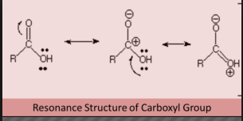

Slide 14
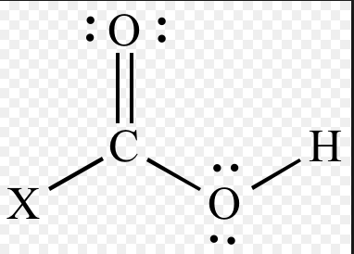

Slide 15
PREPARATION OF CABOXYLIC ACIDS

Slide 16
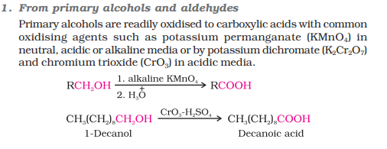

Slide 18
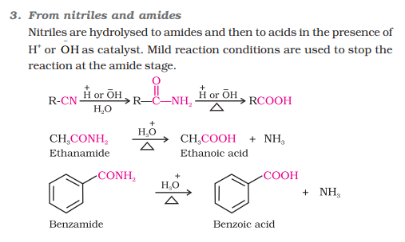

Slide 20
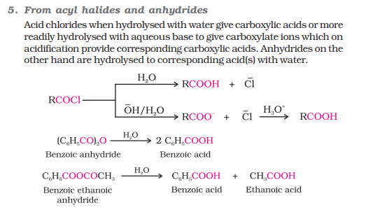

Slide 21
